Slide 1




(23CC505PC) SOFTWARE ENGINEERING
UPPAL CAMPUS
NARAYANGUDA
IBRAHIMPATNAM
LAB EXERCISE – 1
SOFTWARE INSTALLATION & SRS DOCUMENT

Slide 2

SOFTWARE ENGINEERING LAB
(23CC505PC)

Slide 3
SRS Document – A Practical Guide
What is SRS?
A document that captures the complete software requirements.
Importance of SRS:
Acts as a blueprint for development.
Bridges the gap between client and developer.
Basis for validation and verification.

Slide 4
Structure of an SRS Document
1. Abstract
2. Functional Requirements (FR)
3. Non-Functional Requirements (NFR)
4. User Identification
5. Workflow of Each User
6. Use Cases

Slide 5
Abstract
Define the problem clearly.
Explain the purpose of the software/why is this problem important.
What it provides(what feature using which technology/method)
Keep it concise (2-3 sentences).
Outcome/result/use

Slide 6
Example (Spotify-like App)
“In Spotify many users seek a personalized music streaming experience across devices. However, current solutions may lack intuitive interfaces, offline support, or seamless playlist sharing. The proposed system offers a cloud-based music platform allowing users to stream, download, and organize music with personalized recommendations."

Slide 7

Hands-On - Activity Time
Now Let us take up
WhatsApp application
Write the abstract

Slide 8
Let’s Review & Reflect
WhatsApp is a cross-platform instant messaging application that allows users to communicate via text, voice, images, documents, and video calls over the internet. It provides real-time, end-to-end encrypted communication, supports both individual and group chats, and includes features like status updates, media sharing, voice notes, and location sharing. The goal is to provide a secure, fast, and user-friendly communication tool accessible globally.

Slide 9
Identifying Functional Requirements (FR)
[These are Mandatory Requirements]
What the system should do. The specific actions the system must perform.
Functions or services that the software provides to users.
Examples:
FR1: The user shall be able to sign up using an email ID.
FR2: The user shall be able to search for songs, albums, etc. by keyword.
FR3: The system shall allow users to create and modify playlists.

Slide 10
Hands-On - Activity Time
Ok Now identify the FR for
WhatsApp application

Slide 11
Let’s Review & Reflect
Few Sample FRs:
FR1: User registration and phone number verification via OTP.
FR2: View and sync contacts using the phone’s contact list.
FR3: One-to-one text messaging.
FR4: Sending/receiving media (images, videos, documents).
FR5: User profile management (photo, name, about)

Slide 12
Identifying Non-Functional Requirements (NFR)
[These are Optional Requirements]
These describe how well the system should perform.
System attributes like performance, usability, security, scalability etc.
Examples:
- NFR1: The system should respond to user queries within 2 seconds.
NFR2: The application shall be available 24 x 7.
NFR3: The system should be able to handle thousands of users at the same time.

Slide 13
Hands-On - Activity Time
Ok Now identify the NFR for
WhatsApp application

Slide 14
Let’s Review & Reflect
Few Sample NFRs:
NFR1: The system should support billions of users concurrently.
NFR2: Messages must be delivered with <1 second delay in ideal conditions.
NFR3: 99.99% uptime for the service.
NFR4: Data must be encrypted end-to-end.
NFR5: The interface must be responsive and work across Android, iOS, and Web

Slide 15
User s of Spotify
Who will use the system?
Categories of users:
Free User
Premium User
Admin

Slide 16
Hands-On - Activity Time
Ok Now identify the Users for
WhatsApp application

Slide 17
Let’s Review & Reflect
Example:
Registered User: Any person who has signed up using a phone number
Admin (Group Admin): A user who creates a group or is given admin privileges
Unregistered Contact: A contact saved in a user’s phone but not yet on WhatsApp
System (Backend Services): Handles message routing, encryption, sync, and storage

Slide 18
Workflow of Each User
Define workflow [ User role and actions].
Free User Workflow Example:
Browse Music (songs, albums, playlists)
Listen to music (limited access)
Search for music
Create an account
Play songs (with ads and limited skips)
Admin:
Manage user accounts
Moderate content (songs, playlists, comments)
View user activity and statistics
Add and remove content (songs, albums, etc.)

Slide 19
Hands-On - Activity Time
Ok Now identify the Workflow for Registered User for
WhatsApp application

Slide 20
Let’s Review & Reflect
Registered User Workflow:
Registration & Setup
Install the app
Enter phone number
Receive and enter OTP
Set name and profile picture
b) Messaging
View contacts who use WhatsApp
Select a contact to chat
Type and send message
Message gets encrypted, sent to server, then to recipient
View message delivery (✓, ✓✓, ✓✓ blue)
c) Calling
Tap on call icon
Choose voice/video
System connects via VoIP protocol
End-to-end encrypted communication

Slide 21
Let’s Review & Reflect
Group Admin Workflow:
Create a group and name it
Add members from contact list
Assign other admins (optional)
Control settings: allow all to send messages or only admins
Remove/add participants

Slide 22
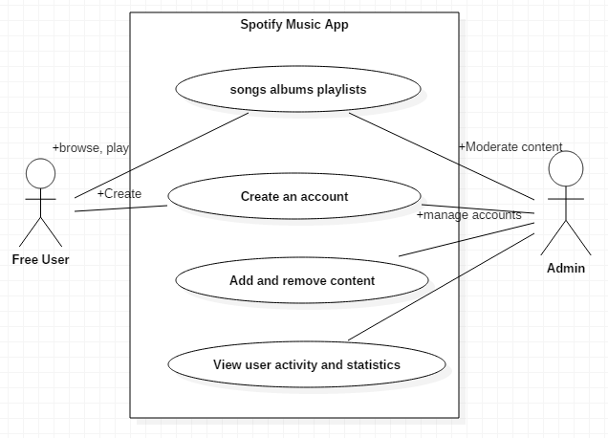
Use case diagram of Spotify

Slide 23
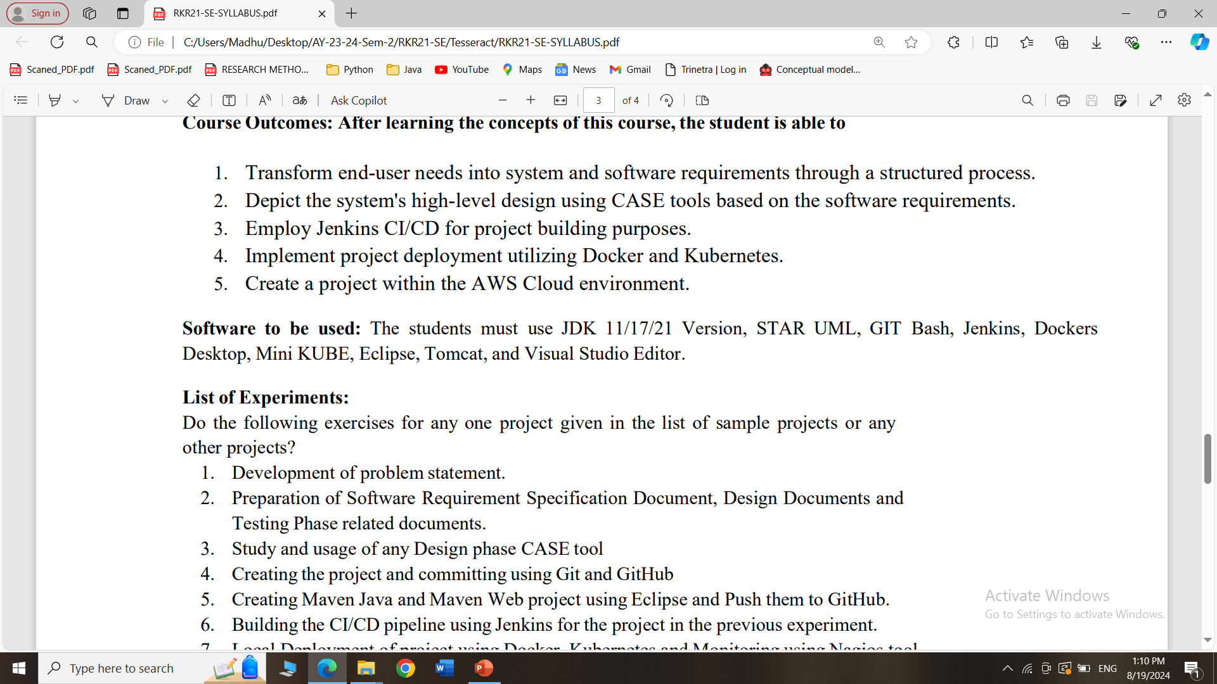
Software Installation

Slide 24
What is the use of STARUML?
StarUML is a software tool used to create diagrams that help in designing and understanding complex systems, especially in software development.
It allows you to visually map out how different parts of a system or application will work together, making it easier to plan, communicate, and build the system effectively.
Think of it as a drawing tool for software engineers to sketch out their ideas.

Slide 25
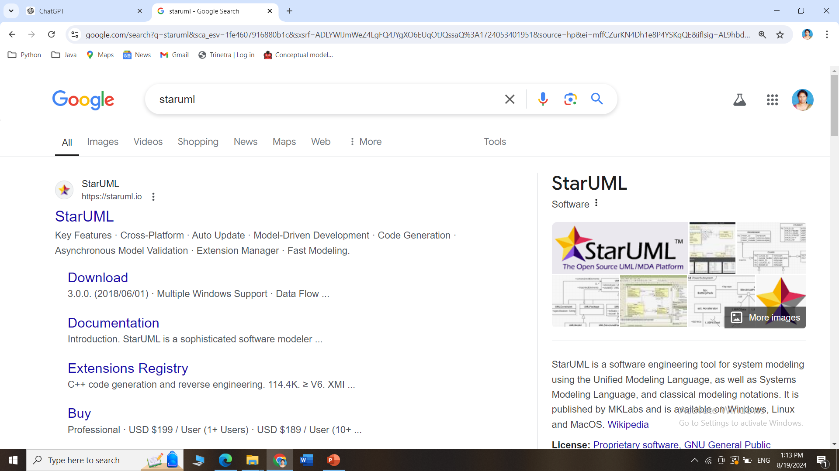
How to install STARUML
Search for StarUML in Google and Click on the official link

Slide 26
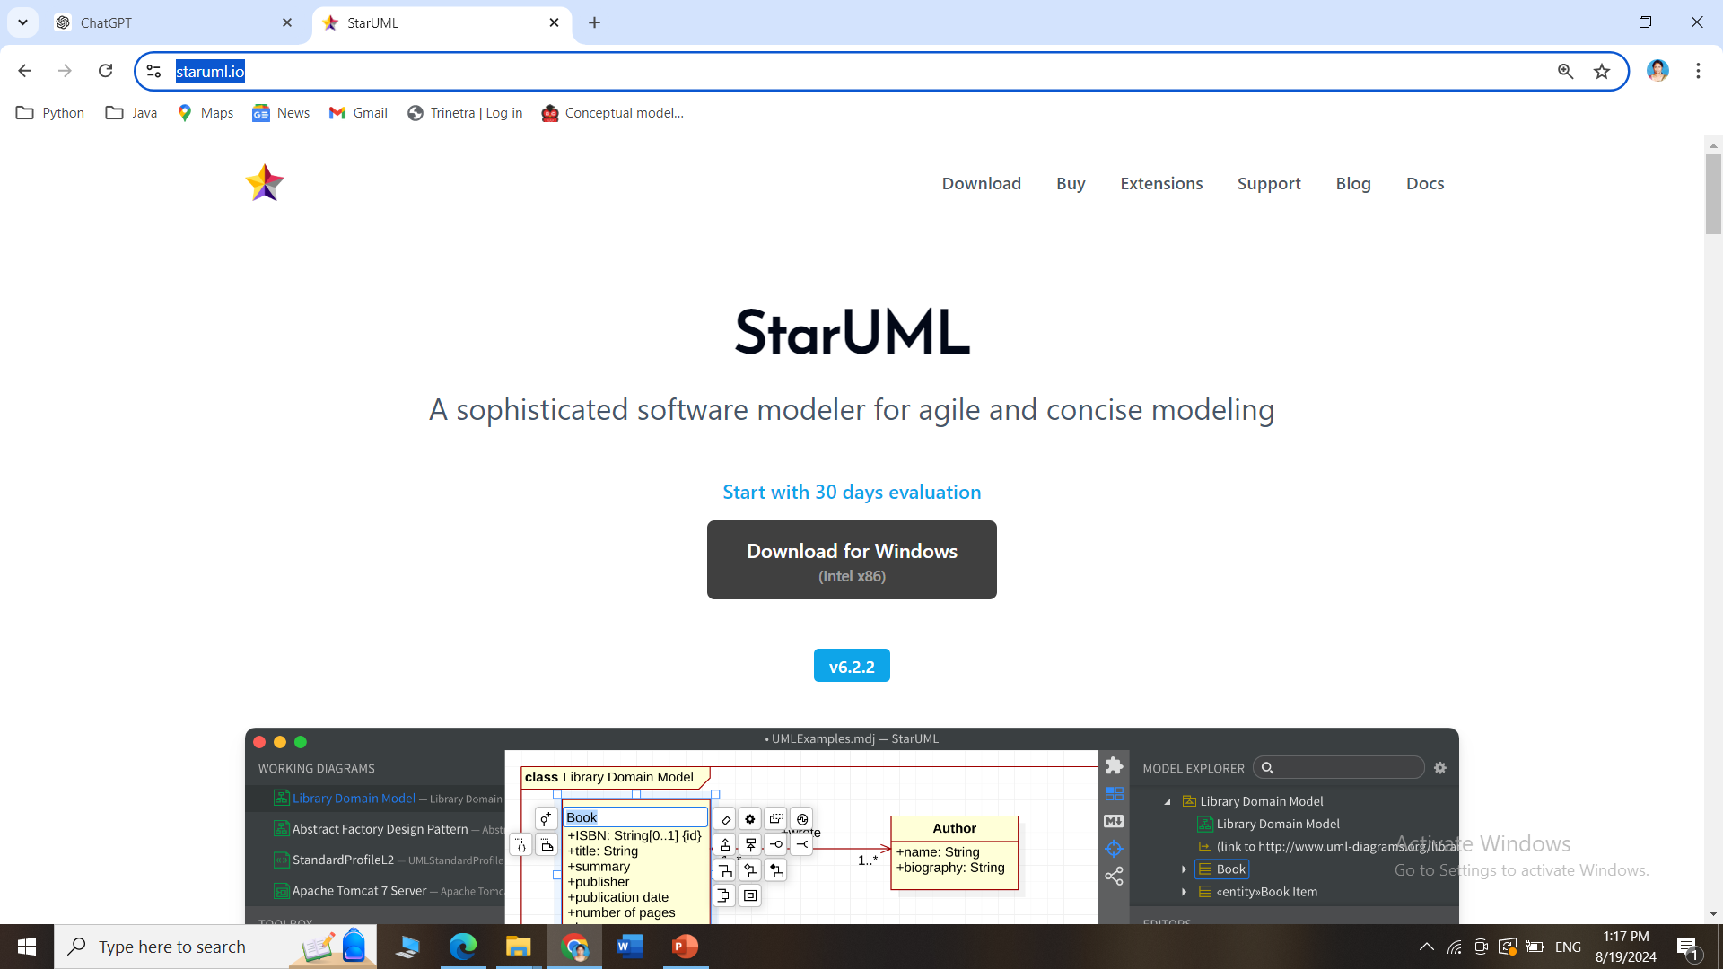
How to install STARUML
Go this site https://staruml.io/ and download StarUML for Windows/Mac

Slide 27
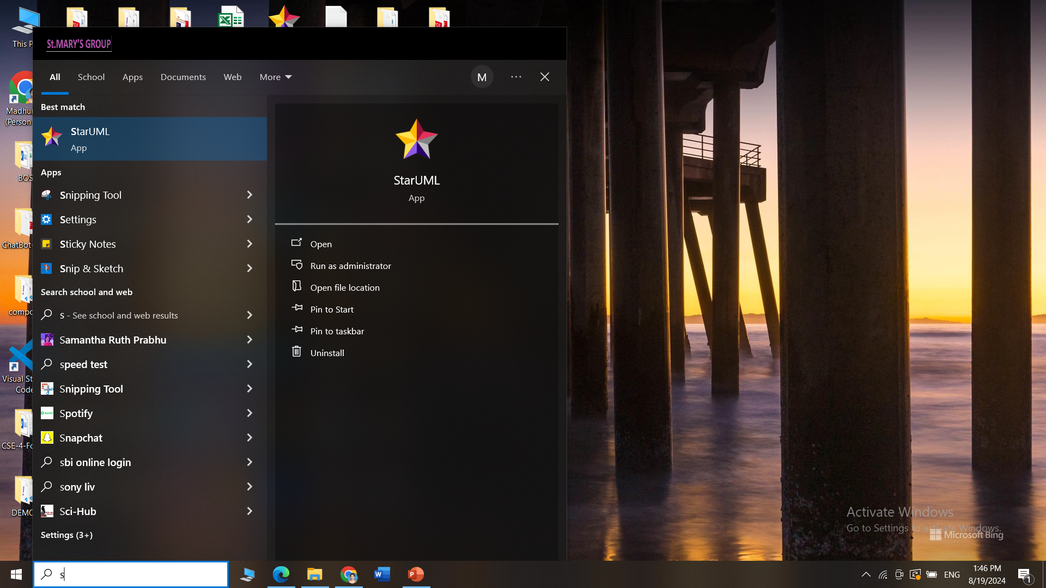
How to install STARUML
StarUML interface after installation

Slide 28
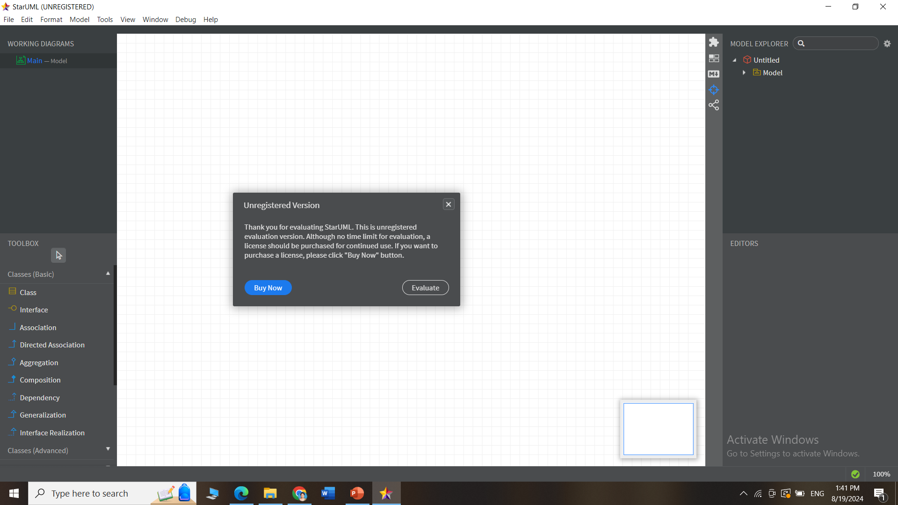
How to install STARUML
StarUML interface after installation

Slide 29
What is the use of GITBASH?
Git Bash is an application that lets you use Git commands on your computer.
Git: A tool for tracking changes in files, mainly used for managing code in software projects.
Bash: A command-line tool that allows you to type in commands to perform various tasks on your computer.
Purpose:
Git Bash combines Git and Bash, so you can easily manage your code and use commands to work with files and projects. It’s like a smart helper for keeping track of changes and collaborating with others on coding projects.

Slide 30
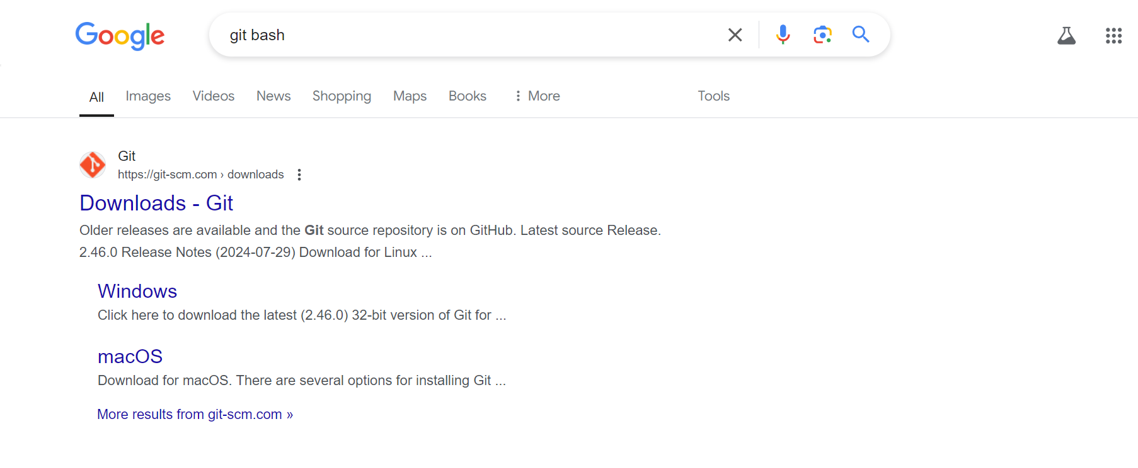
How to install Git
Search for git bash in Google and Click on the official link

Slide 31
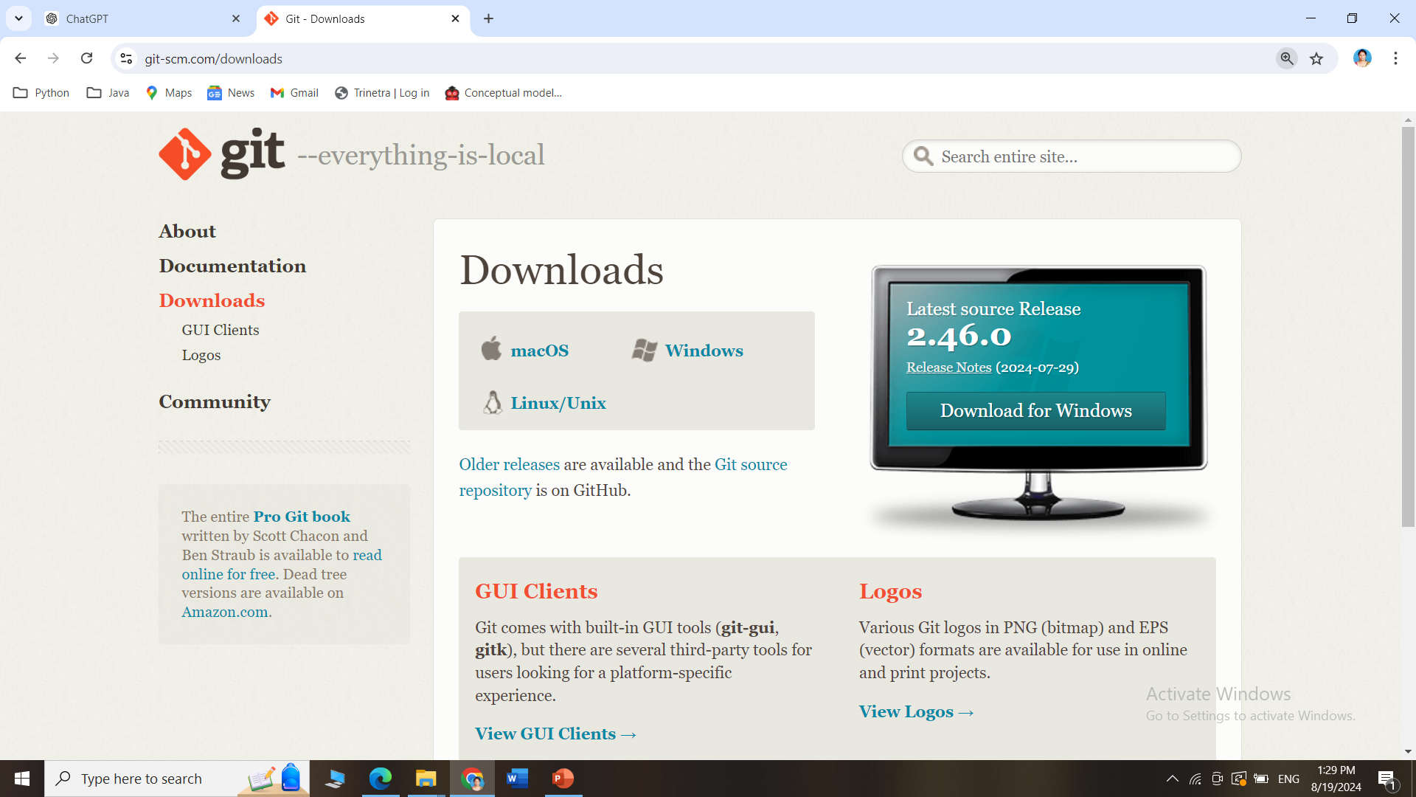
How to install GitBash
Go this site https://git-scm.com/downloads and download Git for Windows/Mac

Slide 32
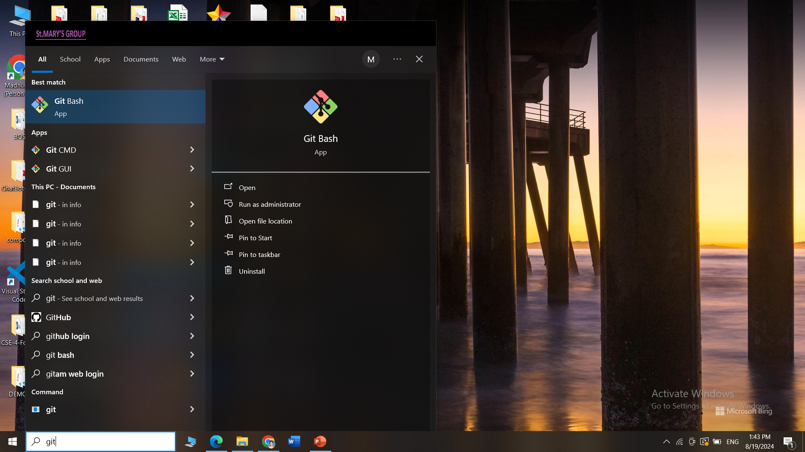
How to install Git
Git Bash interface after installation

Slide 33
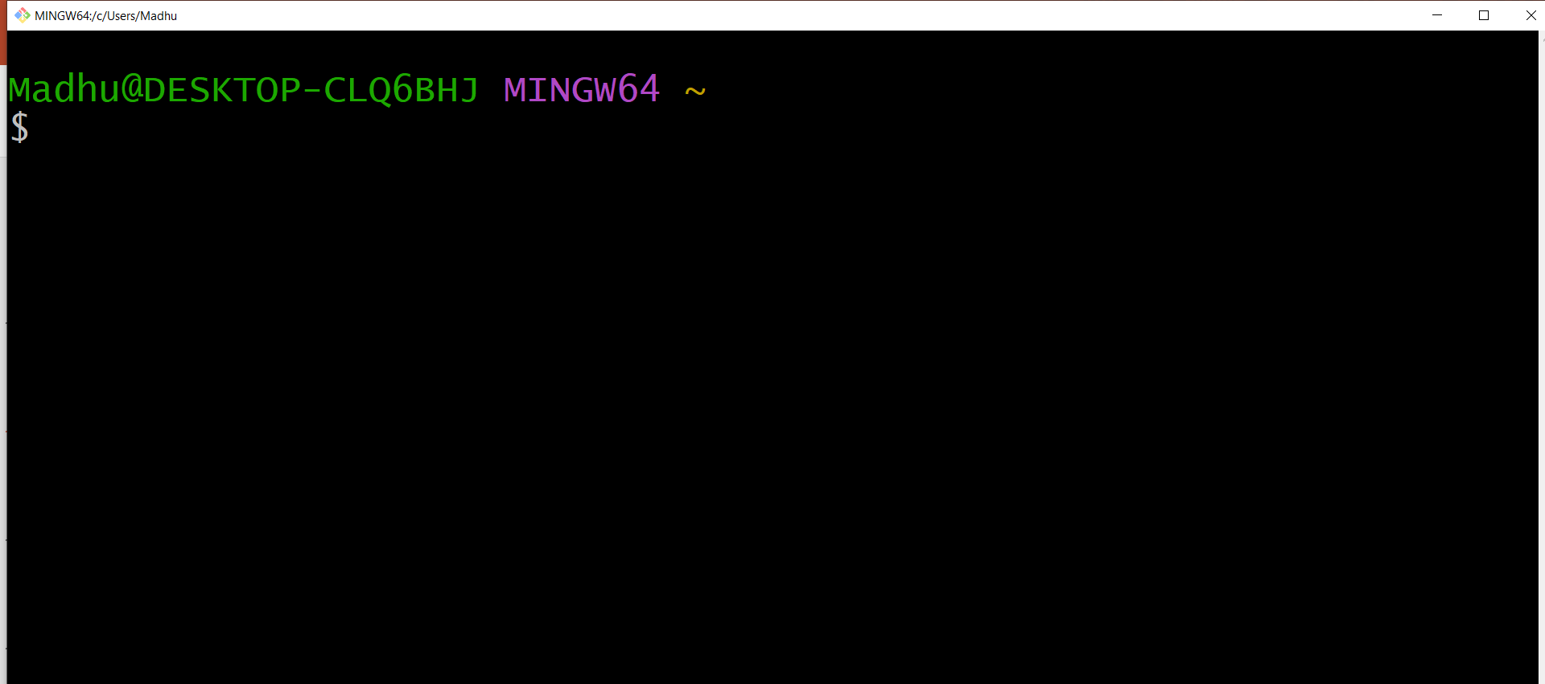
How to install Git
GitBash interface after installation

Slide 34
What is the use of GitHub?
GitHub is a website where people can store and share their computer code.
It's like a big, online folder where you can keep your work, make changes, and collaborate with others.
Think of it as a place where you and your team can work on a project together, track changes, and keep everything organized.

Slide 35
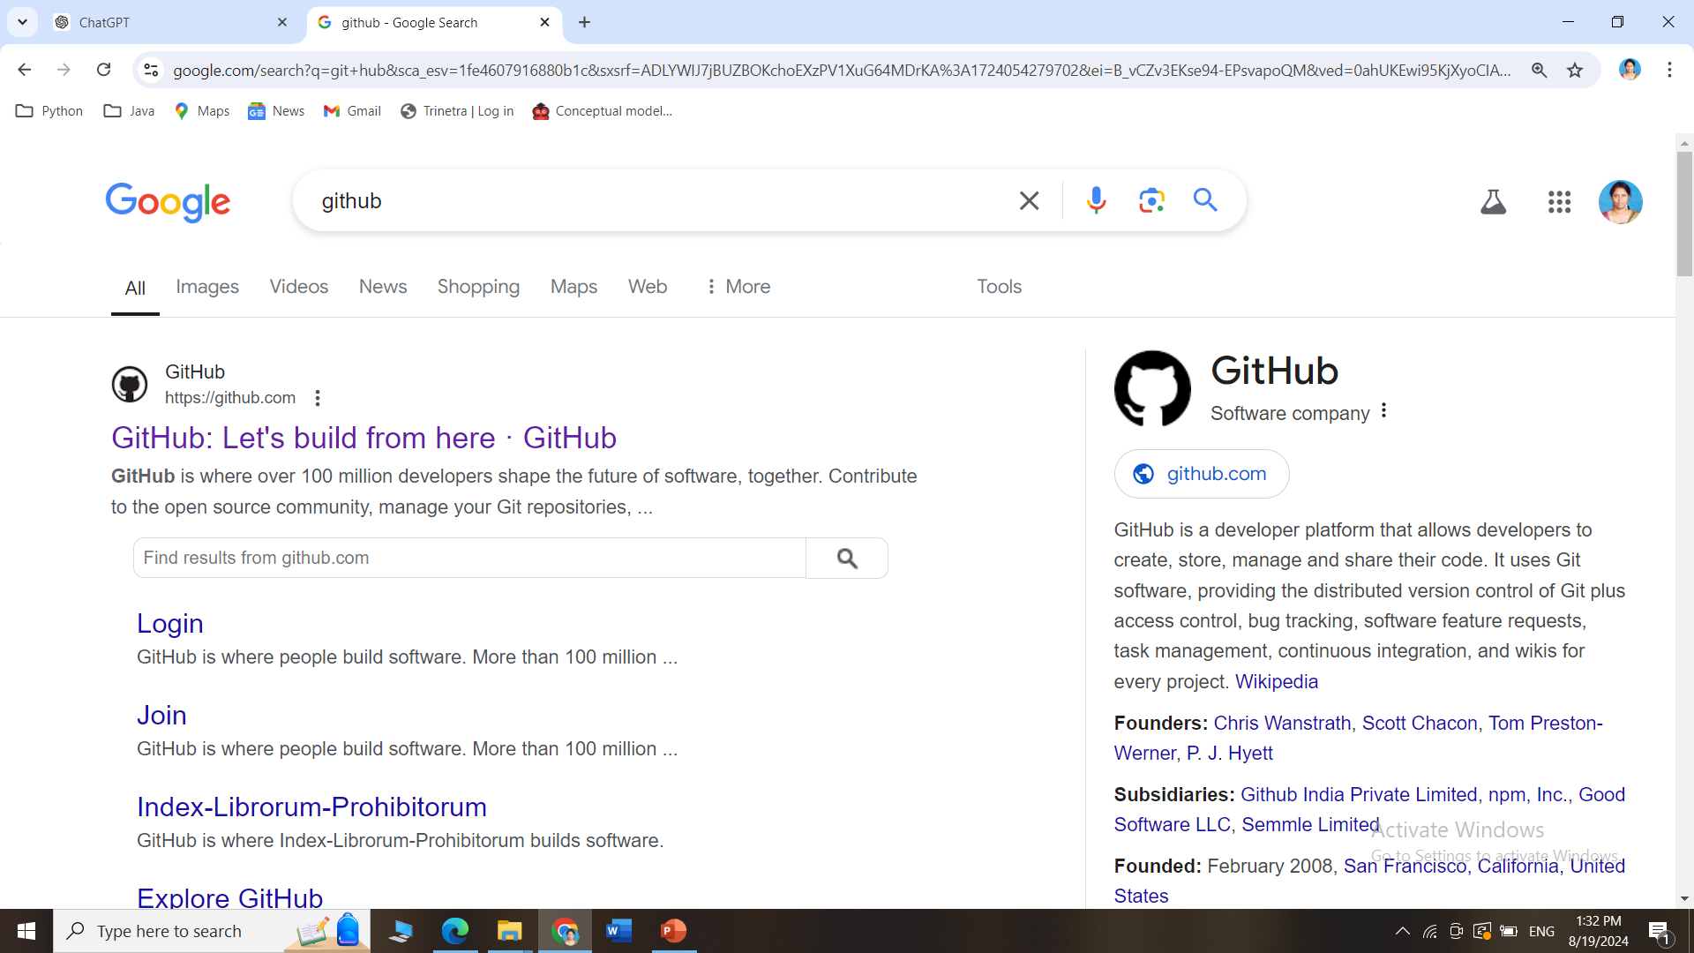
How to create an account in GitHub?
Search for github in Google and Click on the official link

Slide 36
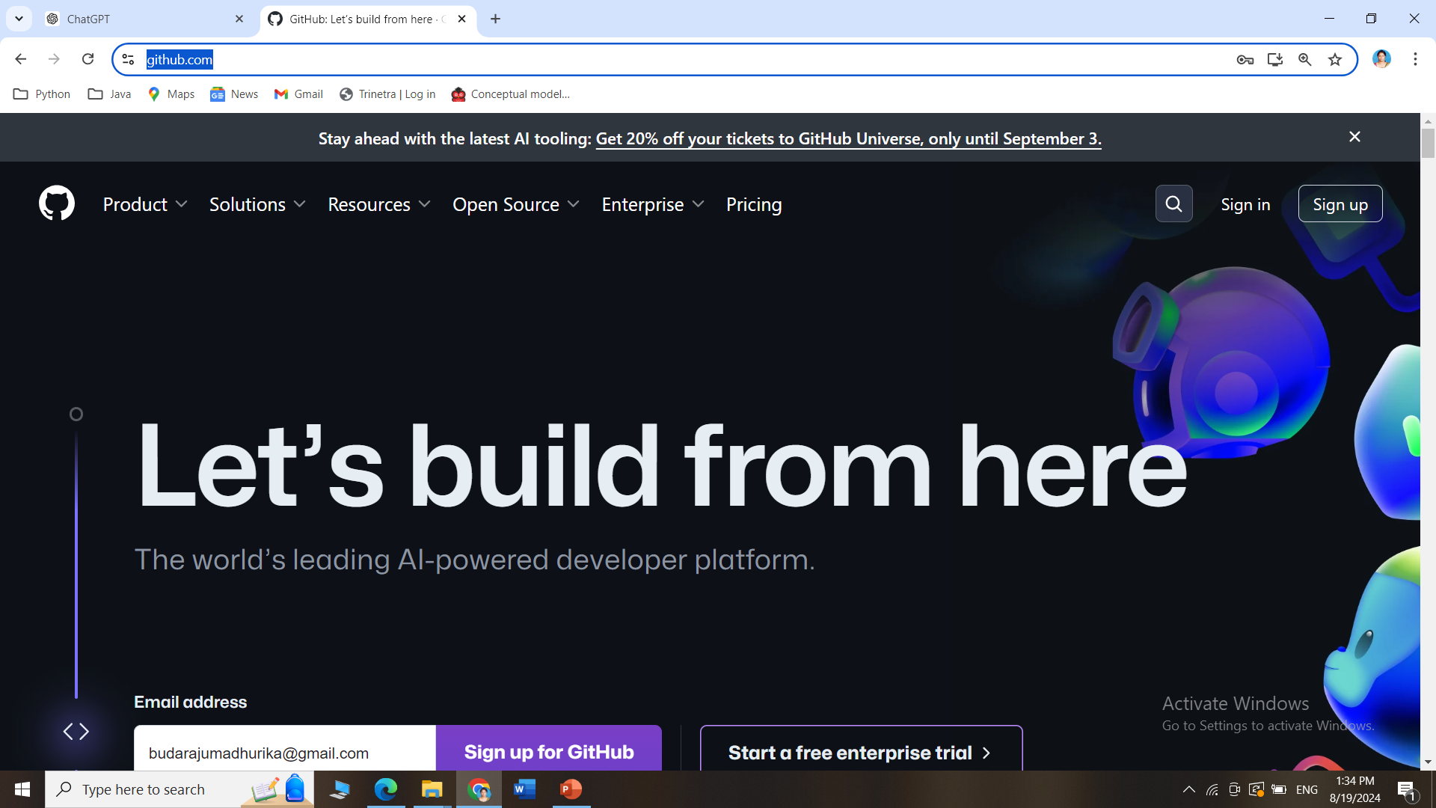
How to create an account in GitHub?
Go this site https://github.com/ and click on Sign Up

Slide 37
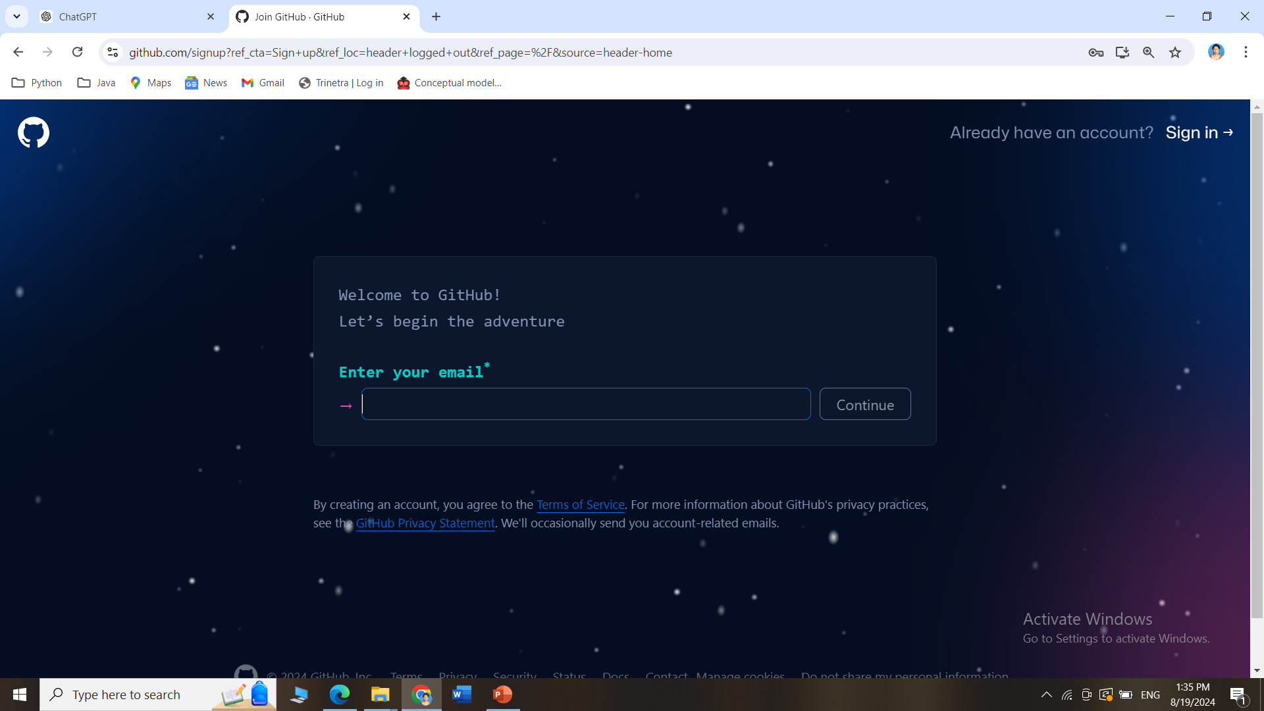
How to create an account in GitHub?
Follow the steps of Signup to create an account in GitHub

Slide 38
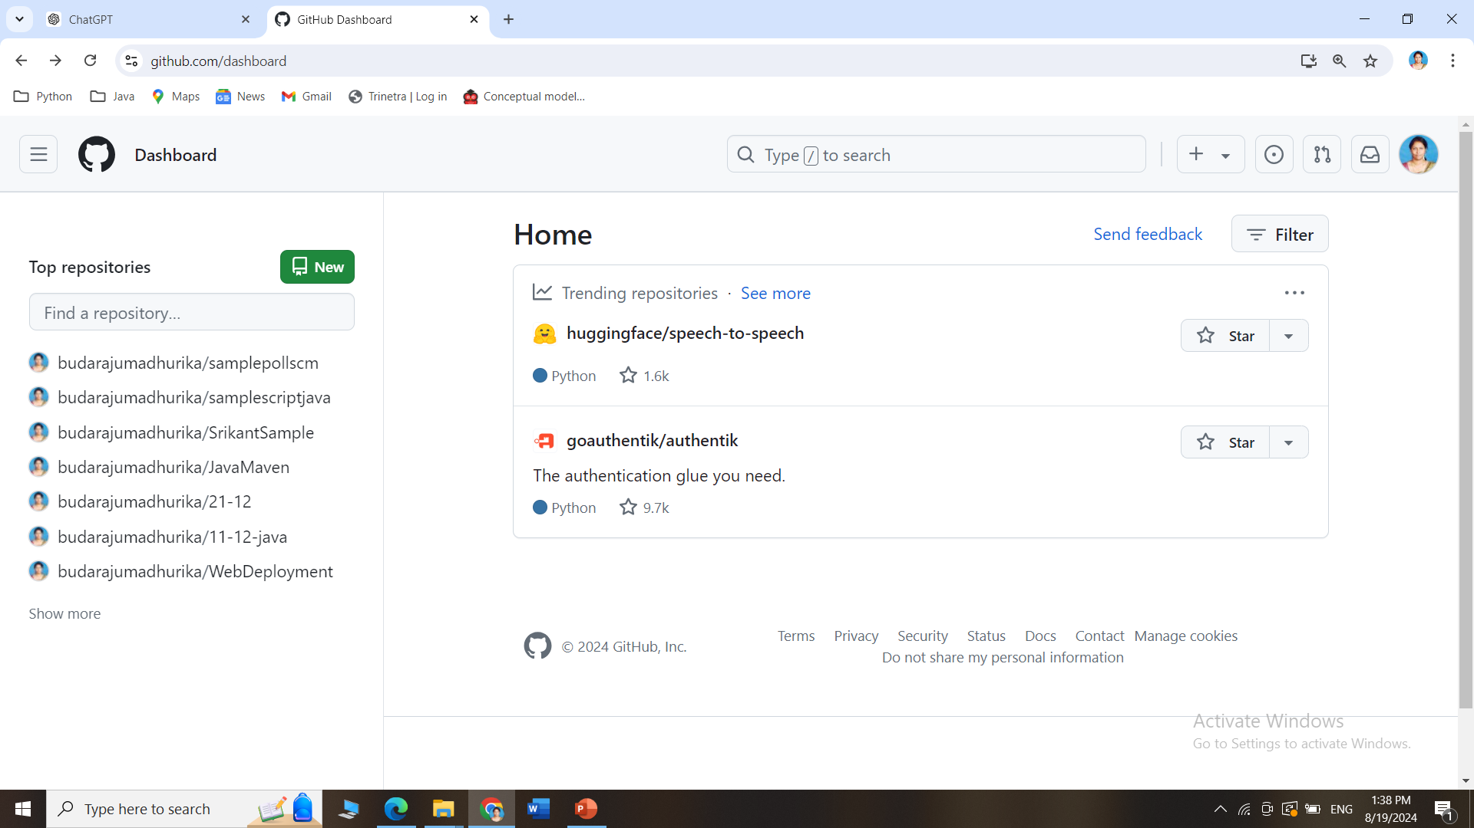
How to create an account in GitHub?
The GitHub dashboard after account creation

